Slide 2
The Importance of Incentives & Rewards @Work
For Colleges and Universities

Slide 3
Guest Lecturer
Short Bio of Guest Lecturer

Slide 4
Seminar Objectives
Learn how to design incentive systems, broadly defined, that shape the behavior and decisions of others in your organization to further the organization’s purpose
We will discuss a set of practices, frameworks and tools for:
Understanding the range of factors that motivate people
Building and managing formal and informal organizational systems for tapping into those motivational factors and driving value-creating behavior

Slide 5
Seminar Agenda
Introduction to Incentives & Rewards at Work
The Psychology of Motivation
Non-Cash Rewards in Practice
Designing Incentive Reward Programs
Determining the Impact
Careers in the Field
Q&A

Slide 6
Example: Cash vs. Gift

Slide 7
Introduction to Incentives & Rewards at Work

Slide 8
What is an Incentive?

Slide 9
“Scientists, and now managers, are realizing that people have a biological need to experience social rewards like praise, the thrill of innovation, and the satisfaction of acquiring new skills. To succeed, every manager needs to realize that work must provide more than just a paycheck and that quenching these social appetites is the key to creating passionate employees whose productivity blows away the bottom line.”

Slide 10
What is an Incentive System?
An incentive system links and aligns: authority and accountability
Authority: Decision Rights
Performance Measurement
Accountability: Rewards and Punishments
who should make decisions?
objective
subjective
objective
subjective

Slide 11
Types of Incentives
Financial Incentives: Bonuses, raises, profit-sharing.
Non-Financial Incentives: Recognition programs, gifts, travel, merchandise, experiences.
Career-Based Rewards: Promotions, professional development opportunities.
Wellness Incentives: Health programs, gym memberships, flexible working locations/hours.

Slide 12
Intangible Non-Financial Rewards & Incentives
Recognition & Appreciation
Flexible Work Arrangements (place and hours of work, ability to leave for appointments, etc.)
Learning & Development Opportunities
Greater Autonomy at Work
Choice of Assignments
Other?

Slide 13
Tangible Non-Financial Rewards & Incentives
Gift Cards/Certificates
Experiences (e.g., spa, dinner out for two)
Group Travel (normally with other high-performers and executives, includes business and leisure activities)
Merchandise (e.g., company swag, large screen TV)
Wellness related (e.g., Gym memberships)
Individual Travel (normally with partner, including flight, accommodation, allowances, etc.)
Other

Slide 14
Why are Incentives & Rewards Needed?
Recognition and Appreciation
Motivation and Productivity
Employee Engagement
Can you think of at least three more?

Slide 15
Why are Non-Financial Incentives & Rewards Needed?
Flexible, not fixed, can be used in small or larger amounts throughout the year
Can be personalized and offer more public recognition
May reinforce company culture more than financial rewards?
Can you think of at least three more?

Slide 16
The Importance of Non-Financial Tangible Rewards in the Workplace
To motivate and direct employees towards the achievement of personal, team and organizational objectives
To align employee efforts with the organization’s priorities
To recognize outstanding performance and outcomes throughout the year
To Encourage Needed Reskilling and Upskilling

Slide 17
The Softer Rewards of Work
“I think done right, non-cash rewards are a great fit for the big movement toward the softer benefits of working in an organization. They are more feeling driven than performance driven. As the research demonstrates, the more an employee feels valued, the more they demonstrate citizenship behaviors.”
– Scott Jeffrey, Management Professor, Monmouth University

Slide 18
The Softer Rewards of Work
“From the leadership point of view today, organizations that do not pay sufficient attention to people and the deep sentiments and relationships connecting them are consistently less successful than those that do.”
– Jeffrey Sonnenfeld, Professor of Management, Emory, Harvard and Yale Business Schools, 1985

Slide 19
The Psychology of Motivation

Slide 20
What is Your Favorite Theory of Human Motivation? Maslow, Hertzberg?
Maslow
Hertzberg

Slide 21
Self Determination Theory, 4-Drive?
Self-Determination Theory
Deci & Ryan
Harvard 4-Drive Theory
Lawrence & Nohria

Slide 22
What Do They Have in Common?
Maslow
Harvard 4-Drive Theory
Self-Determination Theory
Autonomy and purpose are key, but we are also fundamentally social and need to belong.

Slide 23
But People Don’t Always Know What They Prefer
System 1: Fast
System 2: Slow

Slide 24
Dueling Selves

Slide 25
IRF Biometric Preference Experiment
Facial Emotional Expressions
Distance From Screen
Galvanic Skin Response (GSR)
Behavioral Approach or Inhibition System (BIS/BAS)
Eye Tracking
Pupil Dilation

Slide 26
Two Experiments: Visual
Participants prompted with a large award scenario context
Participants asked to choose a meaningful award from set of merchandise, gift cards and travel
Participants asked to choose award type for each scenario

Slide 27
Two Experiments: Audio
Participants prompted with a small and large award scenario context
Participants listened to various types of reward presentations given by various levels of peers and management

Slide 28
Non-Cash Preferred at Both Levels

Slide 30
Cash Often Chosen Out of Need

Slide 31
The Art & Science of Incentive Design

Slide 32
Which Is Best for Your Company?
Discussion with two of your immediate neighbors for five minutes
Choose an organization where one of you worked
Which of the following benefits programs would generate the most value creation per dollar spent at that organization? Why?
Merchandise (TVs, company swag, etc.)
Experiential rewards (e.g., travel, dining out)
Childcare-related benefits
Service sabbaticals
Cash

Slide 33
Rewards for a New World
THEN
Tangible Value
Routine, Repetitive Work
Highly Fungible Labor
Satisfied & Motivated
Extrinsically
Explicit, Contingent
Incentives
NOW
Intangible Value
Non-Routine, Complex Work
Incredibly Difficult to Recruit & Retain Talent
Satisfied Extrinsically, Engaged Intrinsically
Subtle Rewards, Post-Behavior Appreciation

Slide 34
An Emerging Model for Motivation

Slide 35
Cater to Autonomy & Purpose

Slide 36
Don’t Forget the Meaning: Lego Experiment
Subject’s Objective: Build multiple “Bionicles”
Compensation: Declining piece-meal rate ($2.00 initial, $1.89, 1.78, etc.)
Key Observation: When does subject quit?
Scenario A
“Meaningful” Condition”
Subjects build “Bionicles”
measured
set aside
rewarded
Scenario A
“Sysiphus” Condition”
Subjects build “Bionicles”
measured
set aside
rewarded

Slide 37
Lego Experiment
Conclusion
People who did the “meaningful” task were willing to do it for less money
In the meaningful condition, subjects exhibit a reservation wage that is 40% less than their reservation wage when their work is disassembled.
And they were willing to do it for longer.
In the meaningful condition, subjects exhibit a reservation wage that is 40% less than their reservation wage when their work is disassembled.

Slide 38
Leverage Peer Recognition

Slide 39
Leverage Peer Recognition
Adapted from Sapolsky, Behave: The Biology of Humans at our Best and Worst
Receiving Points
Redeeming Points
Lots of
Dopamine
Released
Dopamine Release
No Dopamine
Released
Peer Recognition /
Appreciation
Points Received
Manager
Recognition /
Appreciation
Work
Redemption /
Reward

Slide 40
Experience Matters

Slide 41
Experience Matters
“Psychologically, it is the experience that lives on and the possession that fades away”
We derive greater satisfaction, enjoyment and happiness from buying experiences vs. things
In part, due to “hedonic adaptation”
People tend to adapt quickly to new cars, raises and bonuses (i.e., the thrill wears off fast)
Same is not true for experiences. Indeed, if anything, people tend to upgrade their memories of trips, adventures and other experiences in retrospect, remembering the best elements and forgetting or downplaying the worst

Slide 42
For Some More than Others, Status Matters
Tip: As opposed to cash rewards, non-cash rewards have “trophy value.” It is socially acceptable to talk about a trip , a luxury good, even show off a gold star on a business card, but less acceptable to talk about a monetary reward.

Slide 43
How You Position it Matters: Framing

Slide 44
Framing Matters
Avos Tversky and Daniel Kahnemann demonstrated that the choices we make are also influenced by the way they are framed
Different wordings, settings, and situations will have a powerful effect on decision-makers
The framing effect has consistently proven to be one of the strongest biases in decision making. The ways in which framing can be used are nearly unlimited; from emotional appeals to social pressure to priming
Combined with Prospect Theory (Loss Aversion) the results are even greater

Slide 45
Framing + Experience
“Consuming an experience evokes greater emotion than consuming a material possession.”
Experiential gifts build relationships between giver and receiver. Material rewards may not not to the same degree.
This is true whether or not giver and receiver enjoy the gift together.
The benefits of experiential gifts extend to material gifts that evoke experiential thoughts.

Slide 46
Timing Matters
“When people assess an experience, they tend to forget or ignore its length. Instead, they seem to rate the experience based on two key moments: (1) the best or worst moment, known as the peak and (2) the ending” – Chip & Dan Heath
Daniel Kahneman and Avos Tversky discovered that we remember and gauge any experience by the "peak" of the experience, and the end
The peak is the highest emotional point of the experience
The other key moment is the end of the experience
Don’t strive to create a complaint-free experience. Focus on creating an extraordinary one
Kahneman & Tversky, 1999

Slide 47
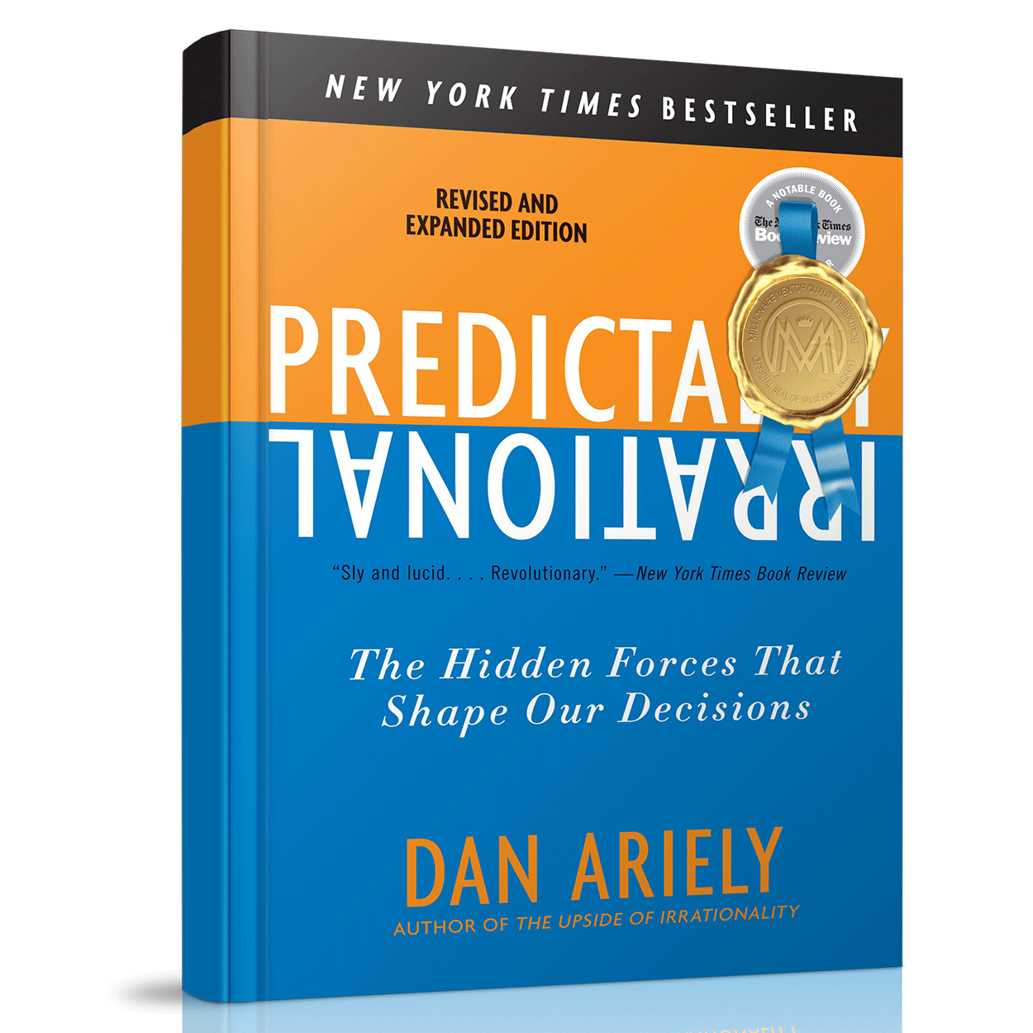
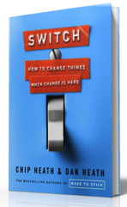
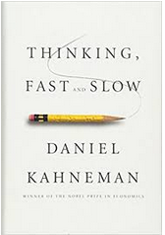
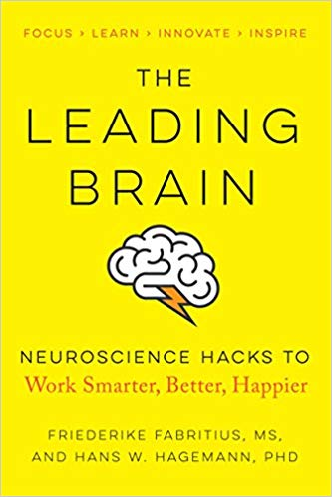
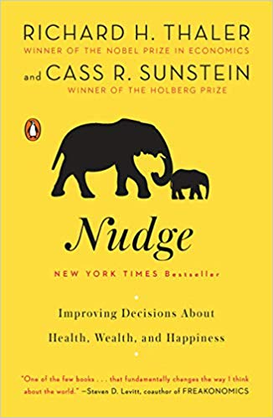
We Don’t Decide in a Vacuum
Your environment strongly influences your choices
You can gently and benignly ‘nudge’ people toward better decisions
Well-designed rewards subtly signal and/or trigger desired behaviors

Slide 48
5 Nudges Worth Knowing: Loss Aversion
Choose
A sure gain of $240
25% chance to gain $1000, and %75 chance to gain nothing
Choose
A sure loss of $750
75% chance to lose $1000, and 25% chance to lose nothing
Tversky, A & Kahneman, D., 1981, The framing of decisions and the psychology of choice. Science, 211, 453-458.

Slide 49
5 Nudges Worth Knowing: IKEA Effect
Michael Norton Daniel Mochon Dan Ariely, Harvard Business School, 2011

Slide 50
5 Nudges Worth Knowing: Endowment Effect

Slide 51
5 Nudges Worth Knowing: Choice Architecture

Slide 52
5 Nudges Worth Knowing: (Amplification)

Slide 53
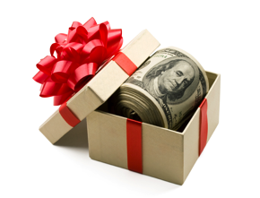
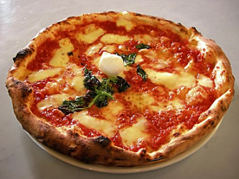
Reward Type Can Drive Performance

Slide 54
Reward Type Can Drive On-Going Performance

Slide 55
A Design Guideline
Use Rewards Subtly, as reinforcements of:
Recognition/Appreciation after a goal is reached or a behavior observed
Recognition/Appreciation reinforced with career opportunities (e.g., promotion, choice of assignment, invitation to present at executive offsite, incentive group travel, etc.)
Carefully select and design incentives to reach a longer-term target (e.g., an annual “President’s Club with incentive travel, tailored gifts, etc.).
Motivators
- Status
- Autonomy
Learning (time to experiment, ‘play,’ learn & develop)
Relatedness (inclusion, respect, belonging)
Purpose (meaningful work, making a contribution)
Innovate, solve problems, generate idea, negotiate, think critically, make complex decisions, build relationships
As a manager/ organization, you rely on your team to:
Path A
Path B
Perform repetitive tasks (physical or administrative) transact with others briefly
Use Rewards Overtly, as Incentives to drive
Recognition/Appreciation Well-designed cash and non-cash incentives
Recognition/Appreciation after a goal is reached or a behavior observed
Motivators
Incentives to reach clear, quantifiable objectives (e.g., production targets, safety goals, sales quotas, etc.))

Slide 56
Beware of Unintended Consequences: Think it Through

Slide 57
Viswanathan et al. (2018)
At a frozen food manufacturer of 580 salespeople, people said that they place a higher value on cash than on merchandise
The firm went from a “mixed” plan (employees earn cash but also points for merchandise like electronics) to a “pure cash” plan
Sales decreased 4.4% (million in losses)
Decrease was smaller for individuals who thought more abstractly about uses of cash, suggesting that the merchandise incentives were motivating because of mental accounting

Slide 58
Gneezy and Rustichini (2000) – Crowding Out
Ten private daycare centers in Israel faced the same problem: parents would arrive late to pick up their children, forcing the daycare to pay teachers to stay after hours
They introduced a fine for late-coming parents
This significantly increased the amount of late pick-ups!
After removing the fine, parents still picked up their children late.

Slide 59
Avoid “Gaming”
Design Robust Metrics: Ensure that the metrics used to determine rewards are comprehensive and aligned with overall organizational goals, reducing opportunities for manipulation.
Regular Monitoring and Adjustments: Continuously monitor the reward system to identify and address any emerging patterns of gaming. Make adjustments as necessary to close loopholes.
Promote Ethical Behavior: Foster a culture of integrity where ethical behavior is valued and reinforced through both formal policies and informal cultural norms.
Incorporate Multiple Performance Indicators: Use a balanced scorecard approach that includes a variety of performance indicators, making it harder to game the system.
Solicit Feedback: Regularly seek feedback from employees at all levels to understand how the reward system is perceived and to identify any unintended consequences early on.

Slide 60
Determining the Impact of Incentives

Slide 61
Tangible and Intangible Returns
TANGIBLE (EXAMPLES)
Retention/Attrition
Customer Retention
Customer Acquisition
Absenteeism
Learning/Development
Overall Performance
INTANGIBLE (EXAMPLES)
Employee Engagement
Employee Satisfaction
Customer Satisfaction/Engagement
Company Culture / Inclusion

Slide 62
The ROI Methodology TM (Cost/Benefit Analysis)

Slide 63
Change Point Analysis

Slide 64
Careers in the Field: Incentive Design

Slide 65
Careers in the Field: Agency / Consulting

Slide 66
Careers in the Field: Corporate Program Manager/ HR/Marketing/Sales & Sales Management

Slide 67
Careers in the Field: Supply Chain

Slide 68
The Importance of Incentives & Rewards @Work
For Colleges and Universities
Q & A

